Slide 1
Job-Driven Technical Assistance Center (JD-VRTAC): Colorado DVR
Jennifer Scilacci
Manager, Partnership Engagement and Communication

Slide 2
Webinar Objectives
Explain JD-VRTAC goals, partners, TA, and Learning Collaborative
Describe SVRA background/services
Explain JD-VRTAC project background
Discuss JD-VRTAC project purpose & goals
Describe JD-VRTAC project implementation
Share JD-VRTAC project accomplishments
Share challenges & lessons learned from JD-VRTAC project
Describe current status of JD-VRTAC project
Discuss what was most helpful from the TA and Learning Collaborative throughout this process
Share next steps, future direction, & goals

Slide 3
JD-VRTAC Goals
Improve skills of state VR agency staff, other rehab professionals & providers of VR services, who are trained to provide “job-driven” VR services & supports to PWD, employers & customized training providers.
Four Topic Areas:
Business Engagement
Employer Supports
Labor Market Information (LMI)
Customized Training Providers
www.explorevr.org

Slide 4
JD-VRTAC Partners
Institute for Community Inclusion (ICI), Univ. of Massachusetts/Boston
In Partnership with:
Jobs for the Future (JFF)
Univ. of Arkansas/CURRENTS
Univ. of Washington
Council of State Administrators of Vocational Rehabilitation (CSAVR)
United States Business Leadership Network (USBLN)
Association of University Centers on Disabilities (AUCD)
In Collaboration with:
National Council of State Agencies for the Blind (NCSAB)
Technical Assistance Center Collaborative

Slide 5
JD-VRTAC Technical Assistance
The JD-VRTAC provides 3 types of TA:
Intensive: 11 VR agencies participated in Cohort 1 of the center’s Intensive TA and 9 agencies will participate in Cohort 2 of the center’s Intensive TA. Agencies receiving Intensive TA become members of a Learning Collaborative to share strategies and solutions.
Targeted: Several agencies have requested targeted TA related to one of the four job-driven topical areas. Additionally, the Center is hosting communities of practice and forums on relevant issues.
Universal: The Center hosts and archives webinars on topics related to the four job-driven topical areas and presents project information at CSAVR and NCSAB.

Slide 6
JD-VRTAC Learning Collaborative
As part of receiving intensive TA, states attended 2-3 in-person Learning Collaborative meetings to provide project updates, collaborate across agencies, and participate in topical discussions
Learning Collaborative states participate in conference calls with their cohort to discuss job-driven topics
18 state VR agencies are part of the JD-VRTAC Learning Collaborative

Slide 7
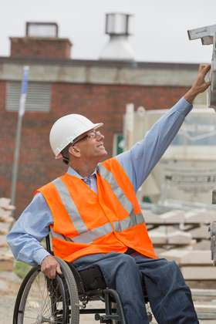
CO DVR – Combined Program
Mission:
We collaborate with our clients to achieve success in their chosen occupations and independent living through our partnerships with businesses, communities and the workforce development system.

Slide 8
CO DVR Programs
Field Service Programs
Business Services Program
Youth Transition Program
Blind Low Vision Services
Office of Independent Living Services
Direct Services in our Field offices to provide excellent customer service to our clients, our community partners, our stakeholders and our staff.
Business services across CO by 8 staff and one manager to educate and provide TA to our business customers and provide placements
SWAP, Aspire, Project Search, dedicated Youth Counselor Leads and a Manager make up our program that is expanding with Pre-Ets and WBLE opportunities
Blind Enterprise Program, Personal Adjustment Training Center, as well as dedicated O&M and counselors in our field offices
DVR provides leadership and contract management to our 9 CILS, as well as membership on the SILC, increasing awareness and partnership with these important stakeholders

Slide 9
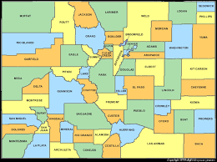
CO DVR: Offices and Staff
Offices: 26
VRCs: 110
Business Outreach Specialists: 8 + 1 new Manager (coming in October!!)
BLVS: 7 counselors, 15 Field and Center based staff + BEP program
And our Amazing A Team: Admin Assistants, PAs and Administrative team
Map of CO:

Slide 10
JD-VRTAC Project Background
How can we increase the wages and quality outcomes of our clients?
Do our counselors have the tools they need and an understanding of LMI to conduct a great comprehensive assessment?
Spring of 2016
CO DVR was working with ODEP’s ESFMLP to finalize a SWOT for our Business Outreach Specialist Program
CO had the opportunity to apply for JD-VRTAC TA in two areas: LMI and Business Engagement
Notes:
Project goals

Slide 11
JD-VRTAC Purpose and Goals
Increase Systematic Use of LMI to produce better client outcomes, include higher wages
Increase Business Engagement Effectiveness through partnerships and skill building

Slide 12
JD-VRTAC Project Implementation
1
Review of ESFMP’s SWOT Analysis of BOS Team
2
Completed survey of BOS team on training needs
3
Refined metrics with help of learning collaborative and completed business services procedure manual
4
Enhanced partnerships with Workforce Centers, co-locations, and targeted sectors

Slide 13
JD-VRTAC Project Implementation
5
Researched LMI tools and decided TCI+ was our choice
6
Trained Leadership on TCI +, Change Management and LMI
7
Developed Communication Plan on TCI+ and LMI for Agency
8
Trained over 50+ Supervisors, leaders, Counselor IIs and business engagement team on TCI +

Slide 14



JD-VRTAC Project Accomplishments
blaj
Business Outreach Procedure Manual
Enhanced services and metrics that align with WFC Partners
Performance Plans that align with PM #6
Co-location with WFCs
Job develop with partners and BDRs
Employment specialist alliances
Increased sector initiative involvement
Employer Brochure
Employer Sell Sheet
Updated Website
Employer and client testimonials

Slide 15
JD-VRTAC Project Accomplishments
Training for Leadership
Training for VRCs
Training for BOS
LMI in Comp Assess Documentation
LMI in VR Academy
New Trainer + LMI

Slide 16
Challenges and Lessons Learned
Implementation when agency has competing priorities
Statewide consistency
Documentation, documentation, documentation
Providing statewide, hands-on training

Slide 17
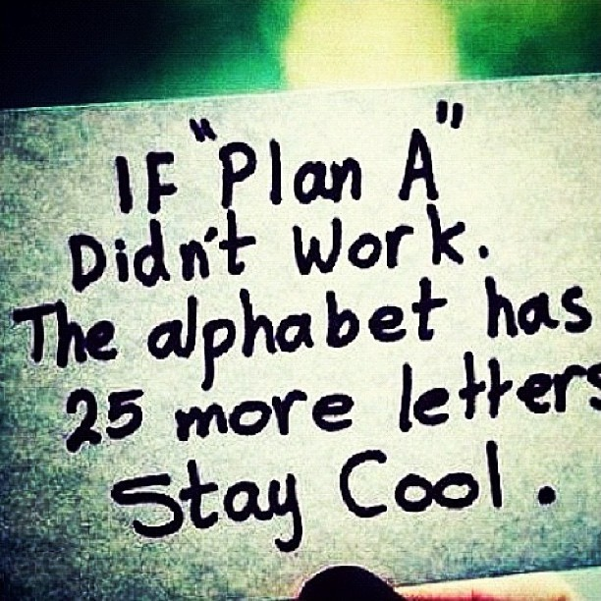
JD-VRTAC Project Today (current status)
Implementation of TCI+ across the state
Enthusiasm of counselors and leadership regarding using LMI and TCI+ as a tool
Increased service documentation to employers and alignment in FS
jj

Slide 18

What was most helpful about receiving TA?
Create a plan
Develop strategies
Create appropriate timelines and deadlines
Review objectives
Collaborate and learn with other states

Slide 19
Next Steps, Future Directions, and Goals
Focus on Sustainability of LMI and TCI+
Dedicated BOS Manager and strengthening alignment and relationships with VRCs and Supervisors
WBL Strategic Initiative
Continue to enhance our partnerships

Slide 20

Questions

Slide 21
JD-VRTAC: CO VR and TA Contact Information
State VR Agency Presenter Contact Information:
Jennifer.Scilacci@state.co.us
970-623-3246
JD-VRTAC TA Contact Information:
Dr. Dana Jefferson
drdanajefferson@earthlink.net
Paula Pottenger
ppottenger@uacurrents.org

